Slide 1



3D Visualization with the ArcGIS API for JavaScript
Kristian Ekenes
@kekenes
Kelly Hutchins
@kellyhutchins
Notes:
Esri Corporate Template-Dark v3.3
16:9 version – January 21, 2016
For more templates, sample files, and icons, see https://compass.esri.com/resources/presentations/Pages/Main.aspx
To add footer text in Windows
On the Home tab, under Insert, click Text, and then click Header and Footer.
Click the Slide tab, select the Footer check box, and then type the footer text that you want.
Click either Apply or Apply to All.
To add footer text on a Mac
On the View menu, select Header and Footer.
Select the Footer check box and then type the footer text that you want.
Click either Apply or Apply to All.
If footers don't appear on the slides
If footers don't appear on title slides, in the Header and Footer dialog box make sure the Don't show on title slide check box is not selected.
If the footers are missing from other slides, the placeholders for these items might have been removed from specific slide layouts or the slide master.

Slide 2

Consistency
Principles of 2D viz ≈ 3D viz
Code is similar
Cartographic principles/techniques are similar

Slide 3
Overview
What you can visualize in 3D
How to do it
Considerations and pitfalls

Slide 4
Overview
What you can visualize in 3D
How to do it
Considerations and pitfalls

Slide 5
What can we visualize?
Location
Types
Data (numbers)
Combinations of the above
Notes:
Show a couple of live samples here showing highlights… Kelly

Slide 6
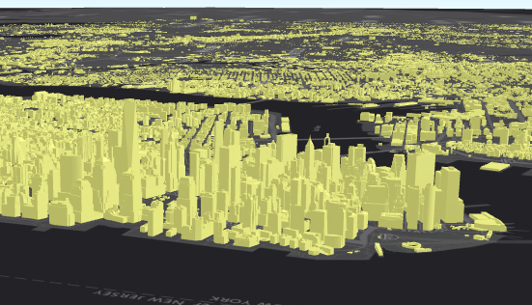
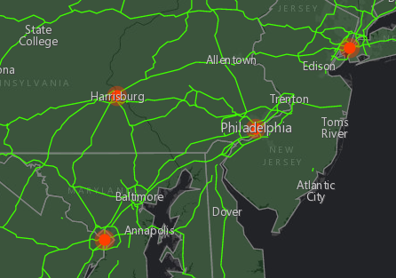
Location
All features in a layer have same symbol

Slide 7
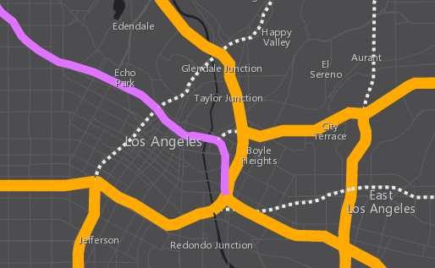
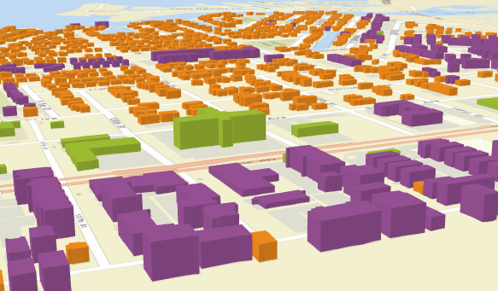
Types
Based on unique (usually text) values
Interstates, highways, major roads, …
Residential, commercial, mixed, …

Slide 8
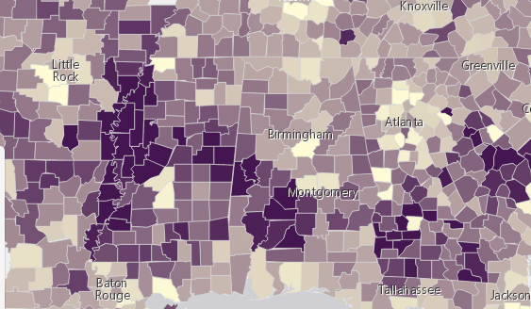
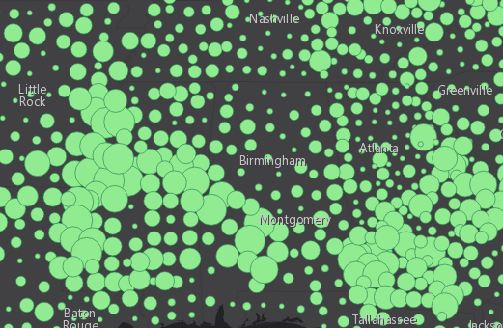
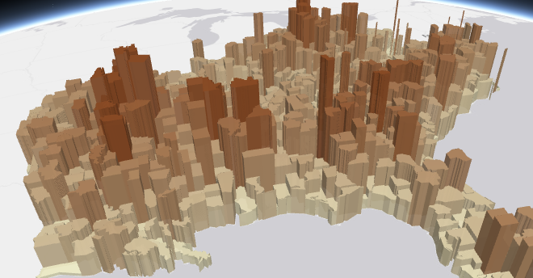
Numbers
Based on field values or functions
Color
Size/Extrusion
Opacity

Slide 9
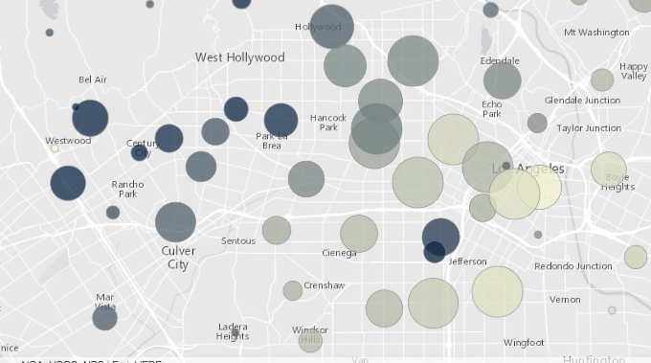
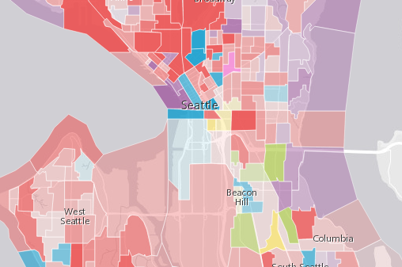
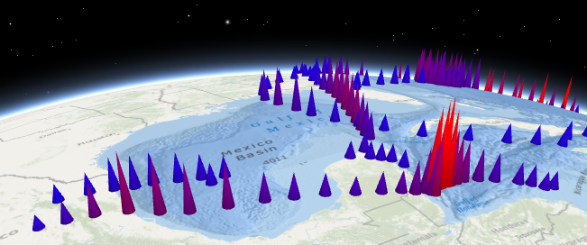
Multivariate viz
Based two or more field values
Color + Opacity
Color + Size
Size + Opacity
Size + Size
(Height + width)

Slide 10
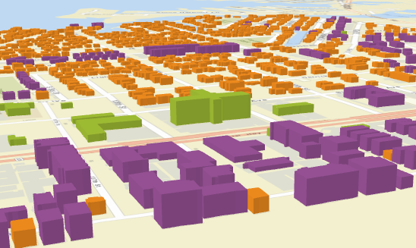
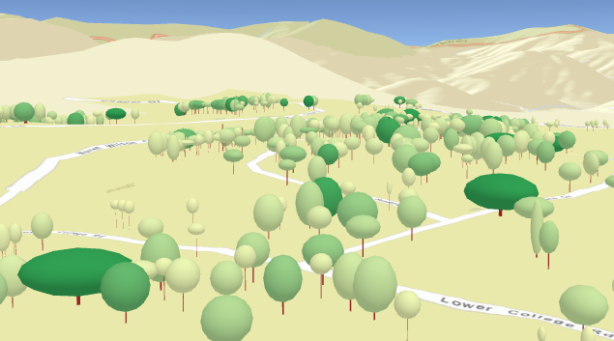
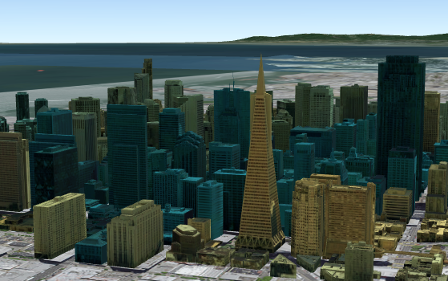
Hybrid thematic maps
Size and shape based on real-world measurements
Color or opacity driven by thematic data
Simplifies or
removes the need for a legend!

Slide 11
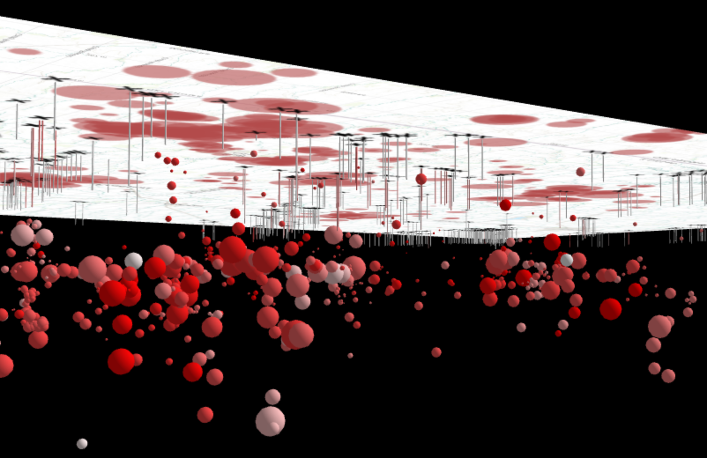
Subsurface mapping
Features with negative z values
Negative extrusions
Only in local scenes

Slide 12
Overview
What you can visualize in 3D
How to do it
Considerations and pitfalls

Slide 13

2D visualization vs. 3D visualization
Renderer
Renderer
3D symbol
2D symbol
2D symbol
Symbol Layer
2D symbol
Visual Variables
Visual Variables
Visual Variables
Visual Variables
Visual Variables
Visual Variables

Slide 14
Symbols

Slide 15
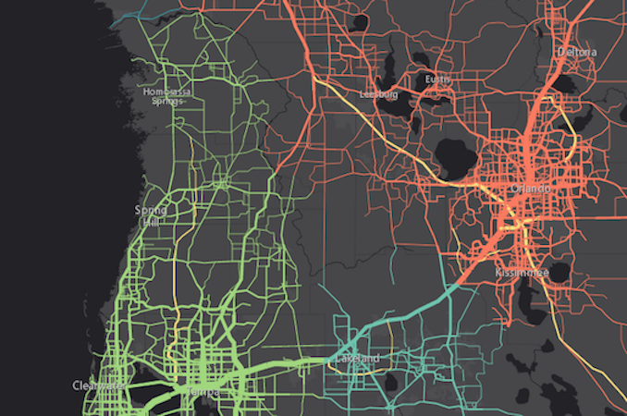
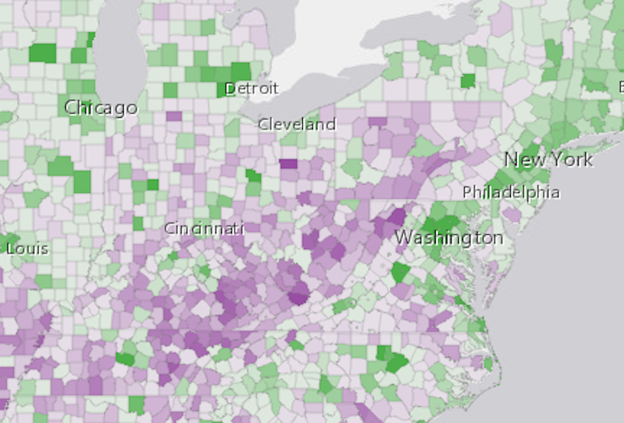
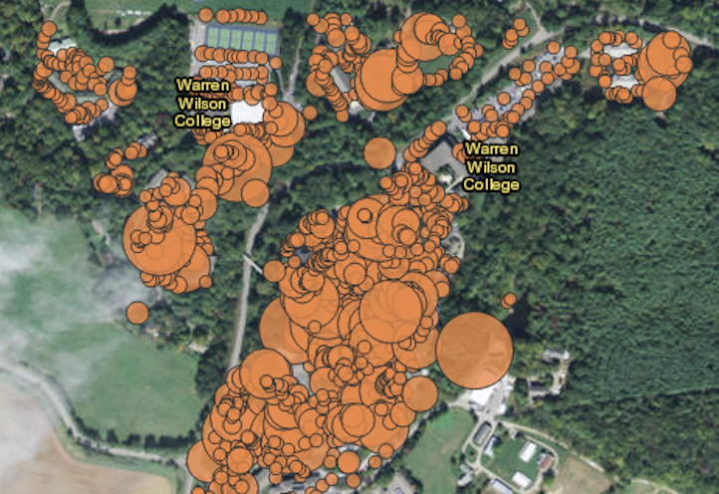
2D Symbols
Not recommended!
All 2D symbols (except PictureFillSymbol) are supported in 3D

Slide 16
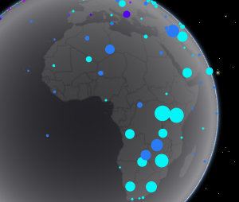
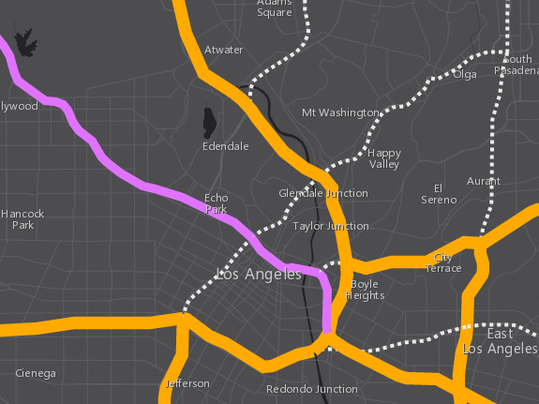
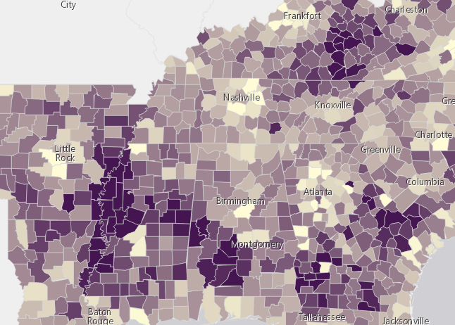
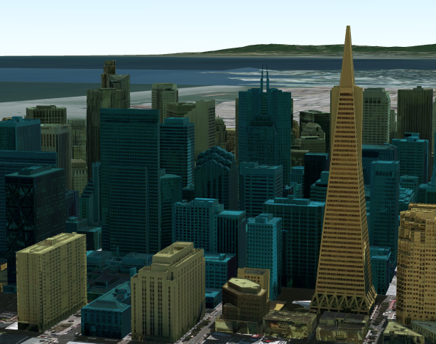
3D Symbols
based on geometry type
Points
Lines
Polygons
Mesh
PointSymbol3D
LineSymbol3D
PolygonSymbol3D
MeshSymbol3D
LabelSymbol3D

Slide 17
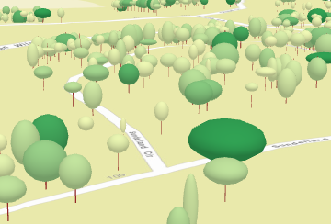
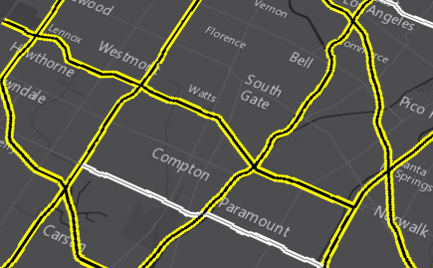
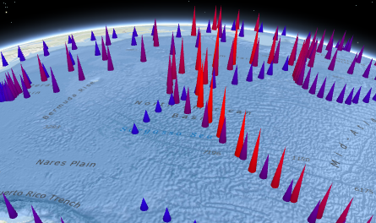
3D Symbols
Each must be composed of one or more symbol layers
Flat
Volumetric

Slide 18
Flat Symbol Layers
IconSymbol3DLayer
Look like they’re 2D
Size is expressed in screen units
pixels or points
FillSymbol3DLayer
LineSymbol3DLayer

Slide 19
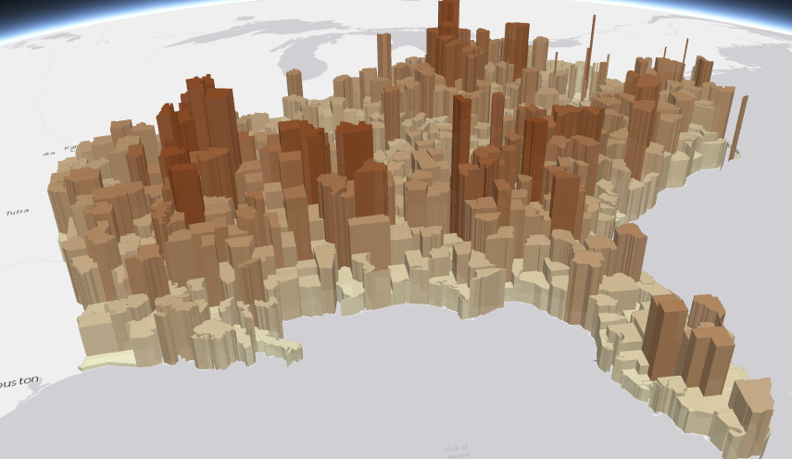
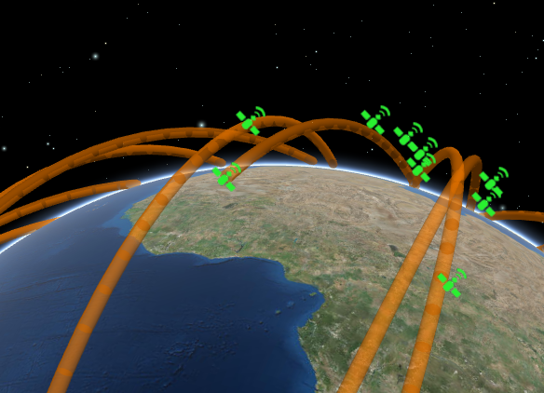
Volumetric Symbol Layers
ObjectSymbol3DLayer
Look like they’re 3D
Size is expressed in real-world units
usually in meters
Object symbol layers (point features) have an axis to size height, width, and depth
ExtrudeSymbol3DLayer
PathSymbol3DLayer

Slide 20
2D visualization vs. 3D visualization
Renderer
Renderer
3D symbol
2D symbol
2D symbol
Symbol Layer
2D symbol
Visual Variables
Visual Variables
Visual Variables
Visual Variables
Visual Variables
Visual Variables

Slide 21
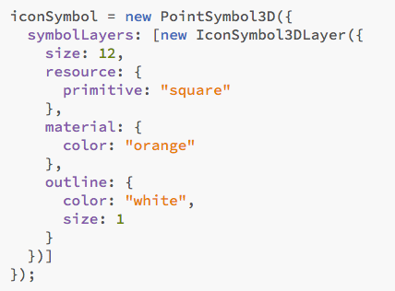
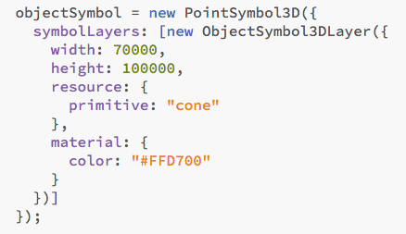
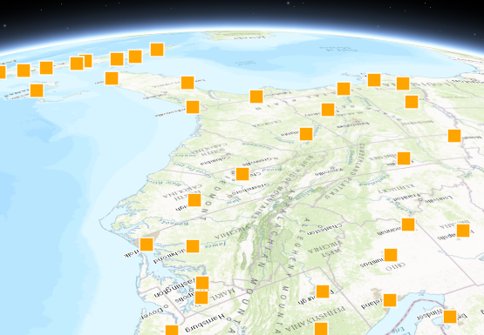
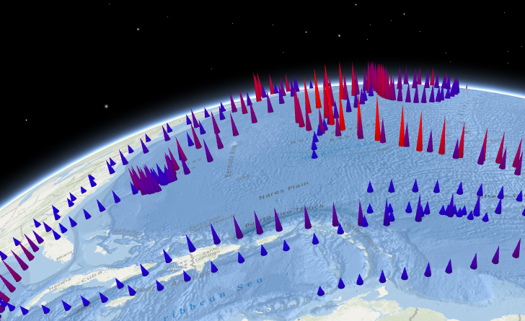
PointSymbol3D
Only for point features
IconSymbol3DLayer
ObjectSymbol3DLayer
Flat (size in points/pixels)
Volumetric (width, height, depth in meters)

Slide 22
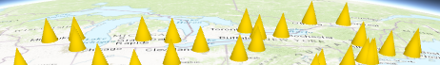
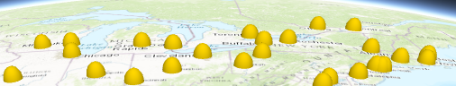
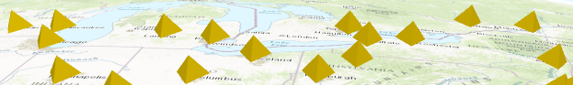
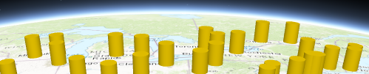
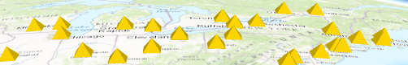
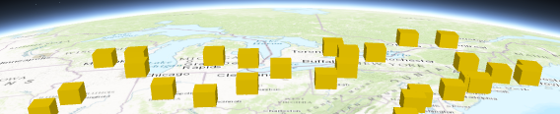
PointSymbol3D
ObjectSymbol3DLayer – resource types
cone
sphere
tetrahedron
cylinder
diamond
cube

Slide 23
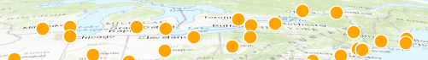
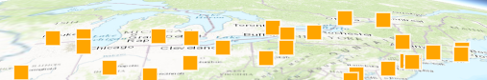
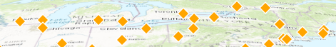
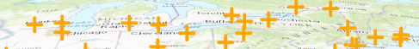
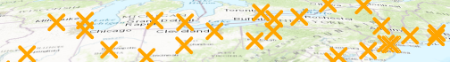
PointSymbol3D
IconSymbol3DLayer – resource types
circle
square
kite
cross
x

Slide 24
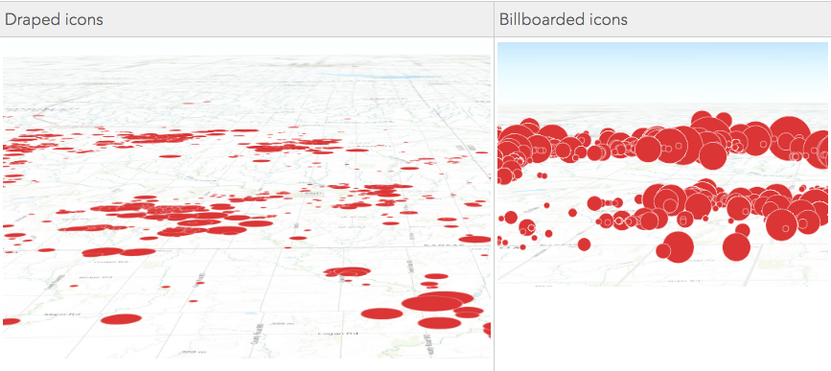
Keep in mind…
Sample comparison: When is each appropriate?
Notes:
Kelly - demos

Slide 25
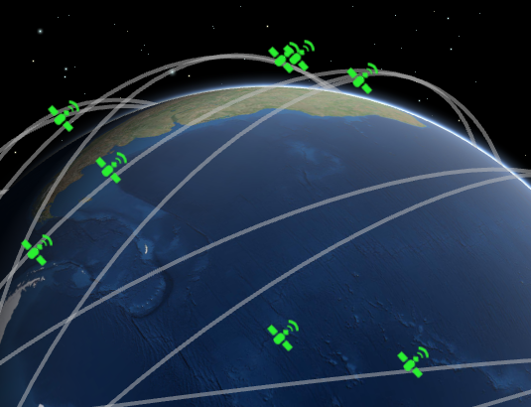
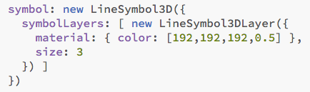
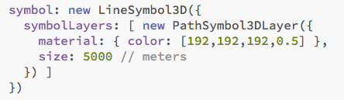
LineSymbol3D
Only for polyline features
LineSymbol3DLayer
PathSymbol3DLayer
Flat (size in points/pixels)
Volumetric (size in meters)

Slide 26
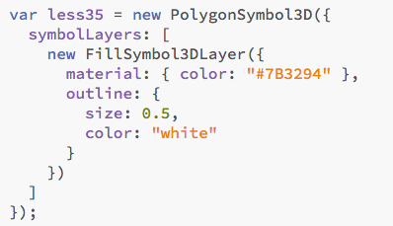
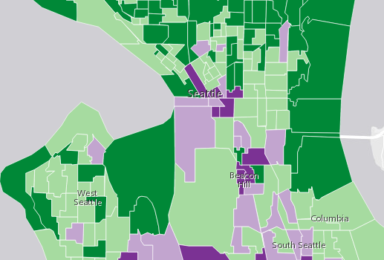
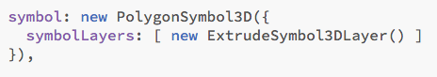
PolygonSymbol3D
Only for polygon features
FillSymbol3DLayer
ExtrudeSymbol3DLayer
Flat (no size)
Volumetric (size in meters)

Slide 27
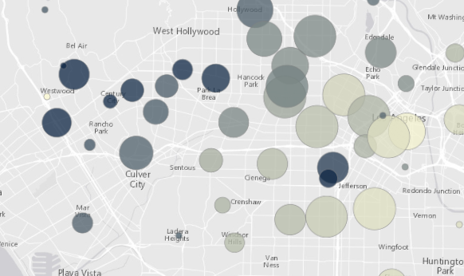
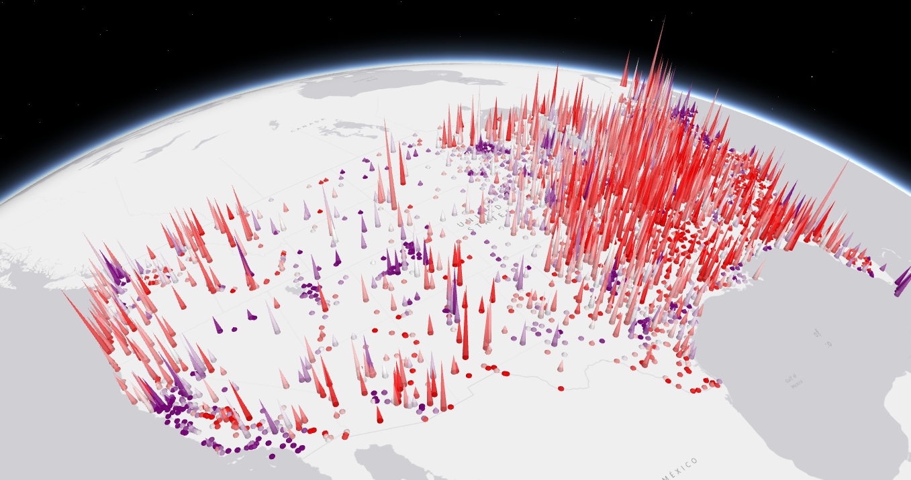

PolygonSymbol3D
Also supports other symbol layers
IconSymbol3DLayer
ObjectSymbol3DLayer
LineSymbol3DLayer

Slide 28


MeshSymbol3D
Only for mesh features (in SceneLayers)
FillSymbol3DLayer

Slide 29


LabelSymbol3D
May be applied to all features
TextSymbol3DLayer

Slide 30
Renderers

Slide 31
2D visualization vs. 3D visualization
Renderer
Renderer
3D symbol
2D symbol
2D symbol
Symbol Layer
2D symbol
Visual Variables
Visual Variables
Visual Variables
Visual Variables
Visual Variables
Visual Variables

Slide 32



Renderers
UniqueValueRenderer
SimpleRenderer
ClassBreaksRenderer

Slide 33

SimpleRenderer

Slide 34


UniqueValueRenderer
Buildings with real-world height

Slide 35


Buildings with real-world height

Slide 36


ClassBreaksRenderer

Slide 37







Visual Variables
A property of the renderer
For numeric data-driven continuous visualizations
Notes:
KELLY

Slide 38


Visual Variables: Color
var colorVV = {
type: “color”,
field: “POP_POVERTY”,
normalizationField: “TOTPOP_CY”,
stops: [
{ value: 0.1, color: “#FFFCD4” },
{ value: 0.3, color: “#350242” }
]
};
Notes:
KELLY

Slide 39


Keep in mind…
Direct lighting
Shade
Notes:
Kelly… comment about color

Slide 40


Visual Variables: Size
var sizeVV = {
type: “size”,
field: “POP_POVERTY”,
normalizationField: “TOTPOP_CY”,
stops: [
{ value: 0.20, size: “4px” },
{ value: 0.65, size: “60px” }
]
};
Notes:
KELLY

Slide 41


Keep in mind…
Flat symbols (pixels or points)
Volumetric symbols (meters)
Good for multiple scale levels
Good for one or two scale levels
Notes:
Kelly…with sample

Slide 42
Visual Variables: Size (real-world units)
var heightVV = {
type: “size”,
field: “HEIGHT”,
valueUnit: “feet”,
axis: “height”
// axis is only relevant for
// ObjectSymbol3DLayer
};
var widthVV = {
type: “size”,
axis: “width-and-depth”,
valueUnit: “inches”
};
Notes:
KELLY

Slide 43

Visual Variables: Opacity
var opacityVV = {
type: “opacity”,
field: “EDUCBASECY”,
stops: [
{ value: 700, opacity: 0.1 },
{ value: 1500, opacity: 0.9 }
]
};
Notes:
KELLY

Slide 44



Keep in mind…
Features behind are visible
Features behind are not visible
Opacity tends to look better in 3D space when there are relatively few features spread out
Notes:
Kelly.

Slide 45


Rotation
No 3D support yet!
Easier to interpret in 2D
where tilt doesn’t interfere
Which direction is this symbol pointing?
Notes:
Kelly.

Slide 46
2D visualization vs. 3D visualization
Renderer
Renderer
3D symbol
2D symbol
2D symbol
Symbol Layer
2D symbol
Visual Variables
Visual Variables
Visual Variables
Visual Variables
Visual Variables
Visual Variables
Notes:
KELLY

Slide 47


Example
Thematic extrusion
Notes:
KELLY

Slide 48

Thematic extrusions
Default symbol
Size visual
variable
Renderer
Color visual
variable
Notes:
KELLY

Slide 49
Advanced cases
Can extend the WebGL engine for complex use cases
Experimental, not stable
http://richiecarmichael.github.io/ocean/index.html#
https://jkieboom.github.io/devsummit-palm-springs-2016/demos/apps/external-renderer/

Slide 50
Overview
What you can visualize in 3D
How to do it
Considerations and pitfalls

Slide 51
Pitfalls
Too many variables = confusion
Be aware of scale (generalize when you need to)
SceneLayer vs. FeatureLayer

Slide 52

Look forward to…
SmartMapping in 3D
No need to guess “good” values.
Generates visually appealing defaults to thematic visualizations in the SceneViewer

Slide 53
Helpful Resources
Get started with visualization
ArcGIS Blog
Icons, lines, fills
Objects, paths, extrusion
Real world sizes
Documentation
Renderer
Symbol3D
Symbol3DLayer

Slide 54


Other Sessions to attend

Slide 55






Please take our Survey
Your feedback allows us to help maintain high standards and to help presenters
Find your event in the Esri Events App
Find the session you want to review
Scroll down to the bottom of the session
Answer survey questions and submit

Slide 56



